Slide 1
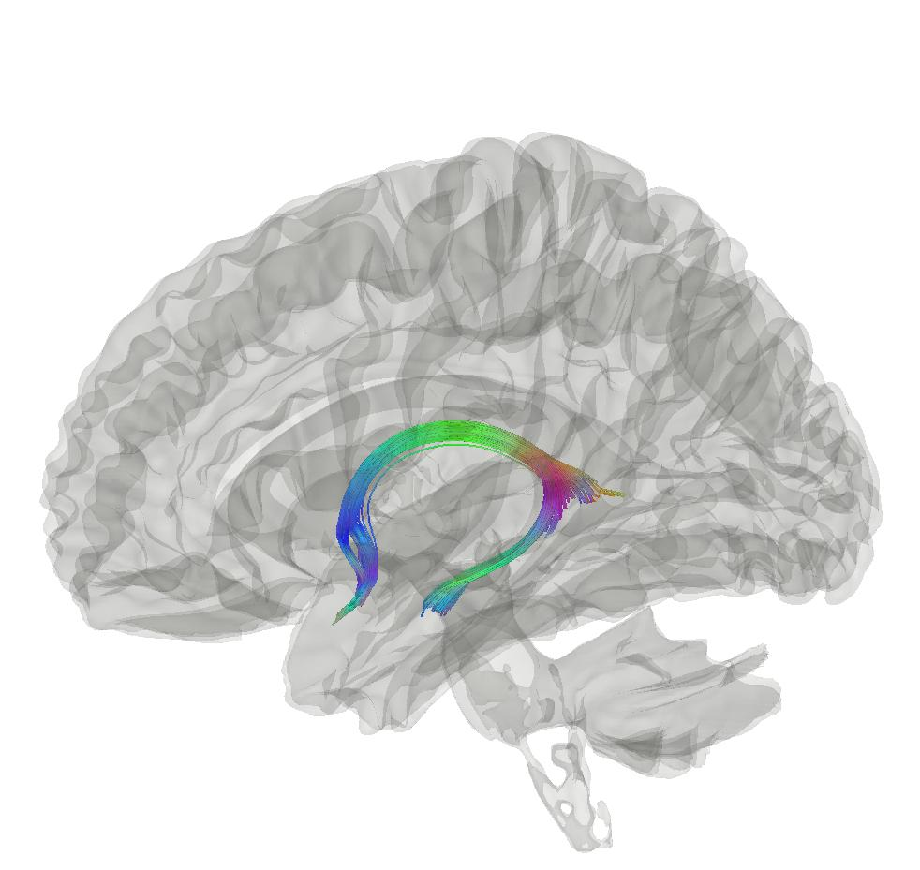



Predicting blood pressure from brain features?
Max Korbmacher
PhD Student at Western Norway University of Applied Sciences, Bergen
Max.Korbmacher@hvl.no

Slide 2
Contents
Background
Brain age gap
Diffusion MRI
Recent Findings
Blood pressure – BAG associations

Slide 3
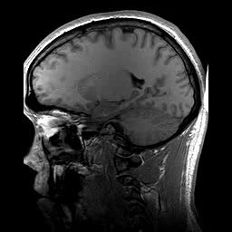
Background: brain age gap
Brain age gap (BAG) calculation
Train a model from MRI data
Make age prediction per individual: “your brain is X years old”
Take the difference between chronological and predicted age
BAG associations
Related to a range of clinical outcomes¹
Higher in some clinical groups vs controls¹
Chronologically 22 years old
Age prediction
Biologically 23 years old
1 Franke & Gaser, 2019, Front. Neurol., 789

Slide 4
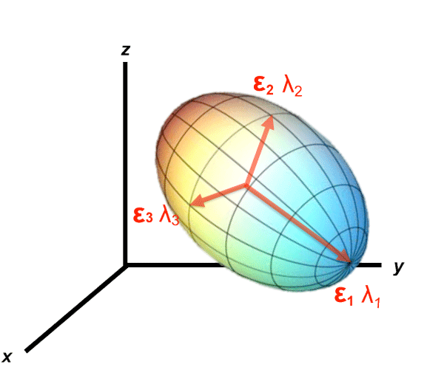
Background: diffusion MRI
Diffusion in the brain
Reveals valuable information about brain structure
Different approaches can be used to calculate diffusion
Most common DTI, but other biophysically more meaningful approaches available¹
e.g. assuming non-Gaussian diffusion (kurtosis) or adding priors (Bayesian approach)
1 Jensen et al., 2005, Magn. Reson. Med. 53

Slide 5
Results: model performance
Brain age prediction model performance
Approach | MRI features | R² | RMSE | MAE | Prediction-Age Correlation | Corrected Prediction-Age Correlation
BRIA | 690 | 0.550 (0.012) | 5.007 (0.057) | 4.002 (0.042) | 0.742 [0.737, 0.747] | 0.892 [0.889, 0.894]
DKI | 207 | 0.576 (0.015) | 4.958 (0.077) | 3.975 (0.068) | 0.754 [0.755, 0.764] | 0.903 [0.901, 0.905]
DTI | 276 | 0.571 (0.014) | 4.983 (0.072) | 3.984 (0.062) | 0.756 [0.751, 0.761] | 0.900 [0.897, 0.902]
SMT | 276 | 0.531 (0.010) | 5.214 (0.053) | 4.183 (0.036) | 0.729 [0.724, 0.734] | 0.899 [0.897, 0.901]
mcSMT | 276 | 0.519 (0.011) | 5.175 (0.045) | 4.153 (0.036) | 0.721 [0.716, 0.726] | 0.892 [0.889, 0.894]
WMTI | 207 | 0.585 (0.012) | 4.903 (0.065) | 3.928 (0.050) | 0.765 [0.761, 0.770] | 0.902 [0.900, 0.904]
Mean multimodal | 28 | 0.393 (0.012) | 5.932 (0.051) | 4.812 (0.046) | 0.627 [0.621, 0.634] | 0.905 [0.903, 0.907]
Full multimodal | 1932 | 0.645 (0.011) | 4.534 (0.041) | 3.624 (0.037) | 0.804 [0.800, 0.808] | 0.907 [0.905, 0.909]

Slide 6
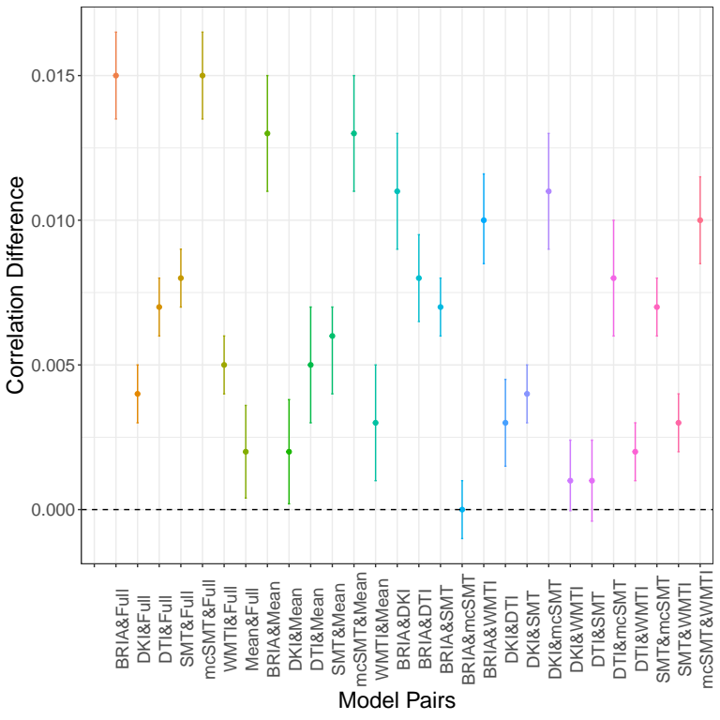
Results: model performance
Small differences in model performance for corrected age
Approach | MRI features | R² | RMSE | MAE | Prediction-Age Correlation | Corrected Prediction-Age Correlation
BRIA | 690 | 0.550 (0.012) | 5.007 (0.057) | 4.002 (0.042) | 0.742 [0.737, 0.747] | 0.892 [0.889, 0.894]
DKI | 207 | 0.576 (0.015) | 4.958 (0.077) | 3.975 (0.068) | 0.754 [0.755, 0.764] | 0.903 [0.901, 0.905]
DTI | 276 | 0.571 (0.014) | 4.983 (0.072) | 3.984 (0.062) | 0.756 [0.751, 0.761] | 0.900 [0.897, 0.902]
SMT | 276 | 0.531 (0.010) | 5.214 (0.053) | 4.183 (0.036) | 0.729 [0.724, 0.734] | 0.899 [0.897, 0.901]
mcSMT | 276 | 0.519 (0.011) | 5.175 (0.045) | 4.153 (0.036) | 0.721 [0.716, 0.726] | 0.892 [0.889, 0.894]
WMTI | 207 | 0.585 (0.012) | 4.903 (0.065) | 3.928 (0.050) | 0.765 [0.761, 0.770] | 0.902 [0.900, 0.904]
Mean multimodal | 28 | 0.393 (0.012) | 5.932 (0.051) | 4.812 (0.046) | 0.627 [0.621, 0.634] | 0.905 [0.903, 0.907]
Full multimodal | 1932 | 0.645 (0.011) | 4.534 (0.041) | 3.624 (0.037) | 0.804 [0.800, 0.808] | 0.907 [0.905, 0.909]

Slide 7
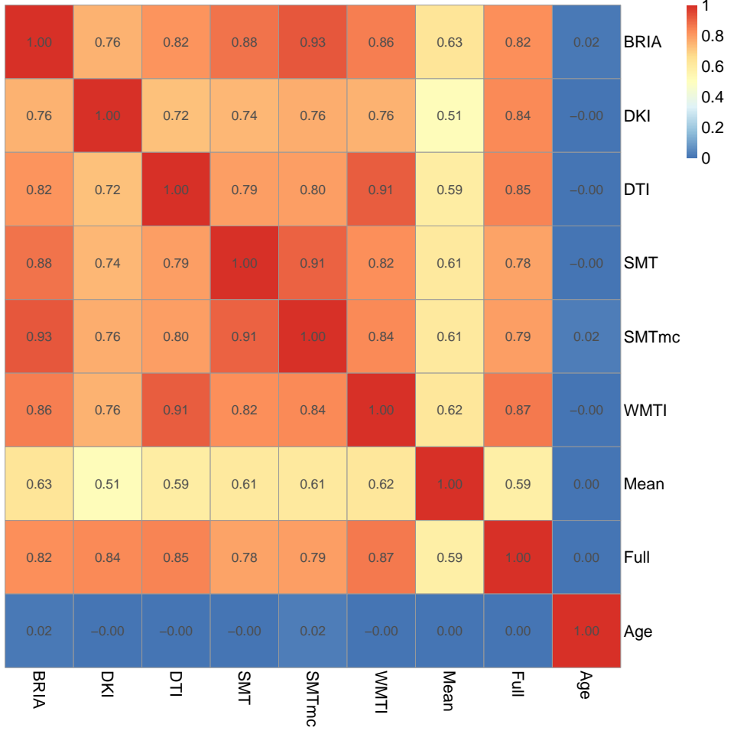
Result: BAG across approaches
Another aspect of assessing comparability across diffusion approaches: BAG
Key message: corrected BAG strongly related across models
Correlations of corrected BAG and age across diffusion approaches

Slide 8
Results: model gain
Fornix metrics contribute most to accurate age predictions (gain)
Top five diffusion metrics ranked by gain in age prediction accuracy
BRIA | DKI | DTI | SMT | mcSMT | WMTI | Multimodal
Micro FA fornix (54957) | MK fornix (39662) | MD fornix (50535) | MD fornix (43563) | Intra fornix (38043) | AWF fornix (52531) | Micro FA Fornix (67749)
Micro RD right external capsule (22860) | RK fornix (26954) | RD FMIN (18386) | MD right anterior corona radiata (24675) | Extra trans Fornix (35799) | RadEAD ATRL (12328) | RD Fornix right Striaterminalis (17664)
Micro FA FMIN (10081) | AK right anterior limb of internal capsule (16340) | RD fornix right stria terminalis (15431) | MD SLFR (19451) | Extratrans right external capsule (15369) | RadEAD right anterior corona radiata | AK anterior right limb of internalcapsule (17664)
Micro FA fornix right stria terminlis (9853) | AK fornix | AD fornix (9637) | MD FMIN (13527) | Extra MD anterior left limb of internalcapsule (6254) | RadEAD IFOFR (9828) | RadEAD right anterior corona radiata (17375)
Micro RD Fornix right stria terminalis (9812) | AK left superior frontooccipital fasciculus | FA fornix left striaterminalis (9283) | FA fornix (12011) | Extra trans anterior right limb of internalcapsule (6126) | RadEAD right external capsule (9793) | RadEAD SLFR (15840)

Slide 9
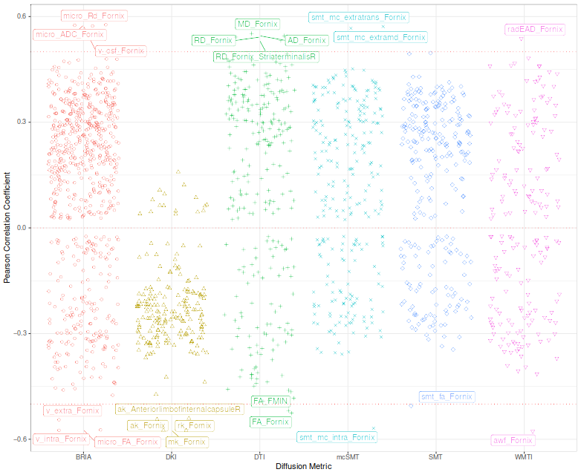
Results: age-metric associations
Fornix contributions to age predictions are reflected in correlations
Strongest age-metric correlations in fornix
Correlations between diffusion metrics and age

Slide 10
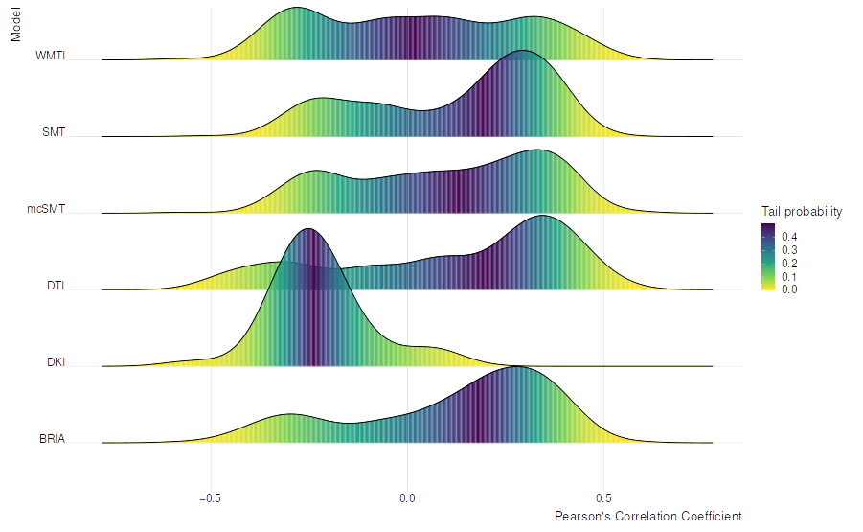
Results
Fornix contributions to age predictions are reflected in correlations
Strongest age-metric correlations in fornix
Correlations between diffusion metrics and age

Slide 11
Brain age & blood pressure
How to bring cardiovasculature and brain together?
Some things I have tried:
Key variables are pulse pressure (outcome), age, diffusion features (or WM diffusion brain age as simplification), waist to hip ratio

Slide 12
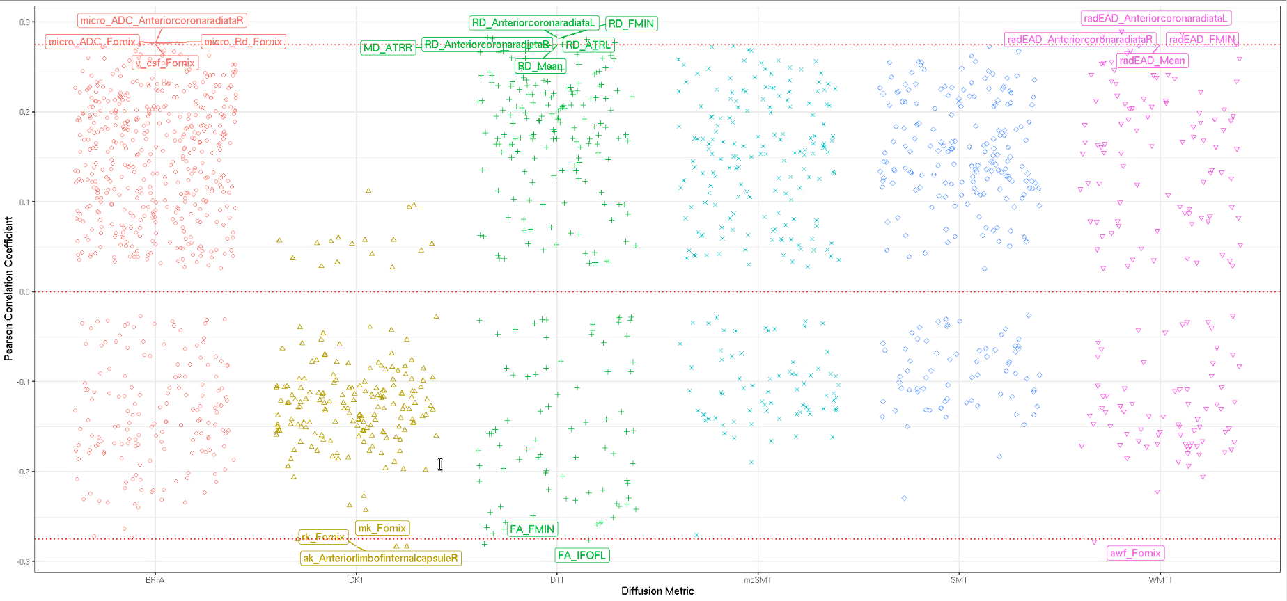
Brain age & blood pressure
Diffusion feature – pulse pressure associations
Fornix pops up again, but is this potentially a function of age? (arbitrary threshold of |r|=.275)

Slide 13
Brain age & blood pressure
When applying XGBoost predicting PP from diffusion features
R² = .138 (SD = 0.037), MAE = 10.707 (SD = 0.438)
When applying a simple linear model PP ~age R² = .191, age beta = 0.836, SE = 0.01
Adding sex & sex*age&age² interactions the model doesn’t become much better, which doesn’t say sex isn’t an interesting variable

Slide 14
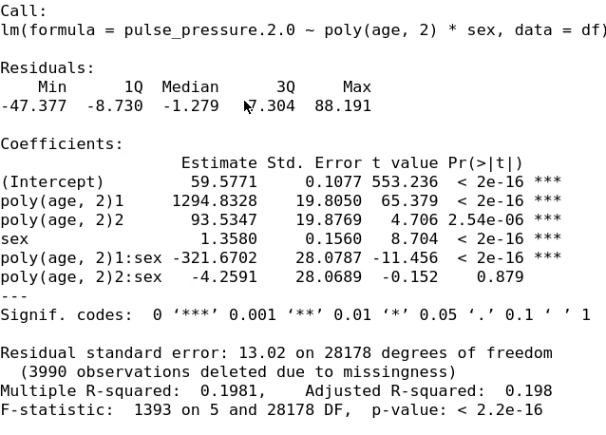
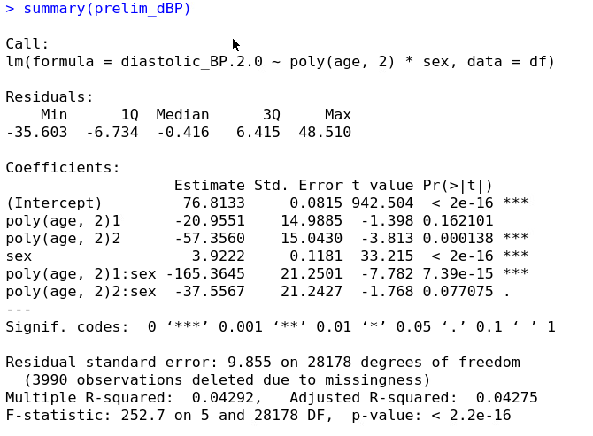
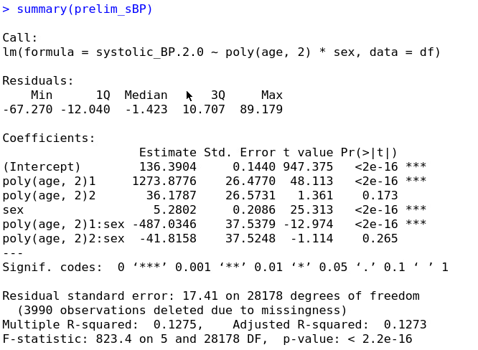
Brain age & blood pressure

Slide 15
Brain age & blood pressure
My thinking so far: if simple linear models with age and sex explain quite some of the variance in blood pressure, why not keeping it simple?

Slide 16
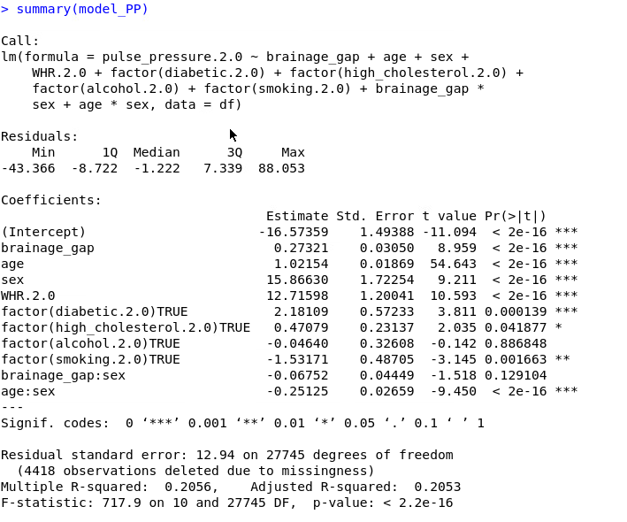
Brain age & blood pressure
Building on the simple linear models
Large differences between sexes and strong influence of WHR
Sneaking but steady age effect?!

Slide 17
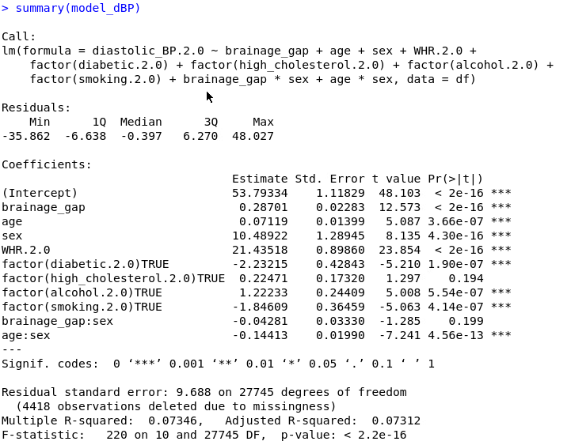
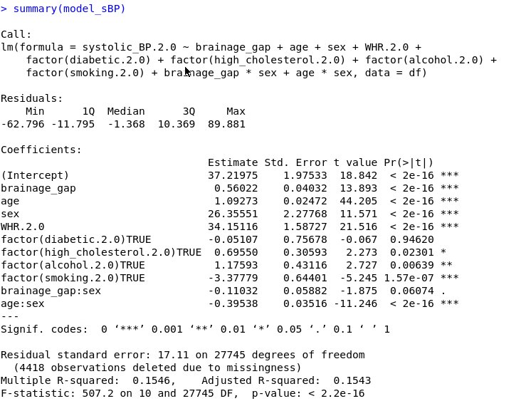
sBP & dBP
Larger differences between sexes and strong influence of WHR for systolic BP
Age effect not as pronounced for diastolic BP?

Slide 18
Brain age & blood pressure
Where to go from here?
Investigate hypertension vs non-hypertension
Calculate BAG from dMRI GM & add it to the linear models
Replace BAG with fornix metrics?
Other ideas?

Slide 19


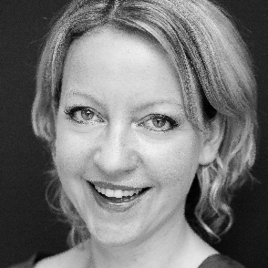





Ivan I. Maximov
Lars T. Westlye
Eli N. Eikefjord
Arvid Lundervold
Thank you!
Dennis van der Meer
Ann Marie de Lange
Dani Beck
Ole A. Andreassen

Slide 20
Supplementary slides

Slide 21
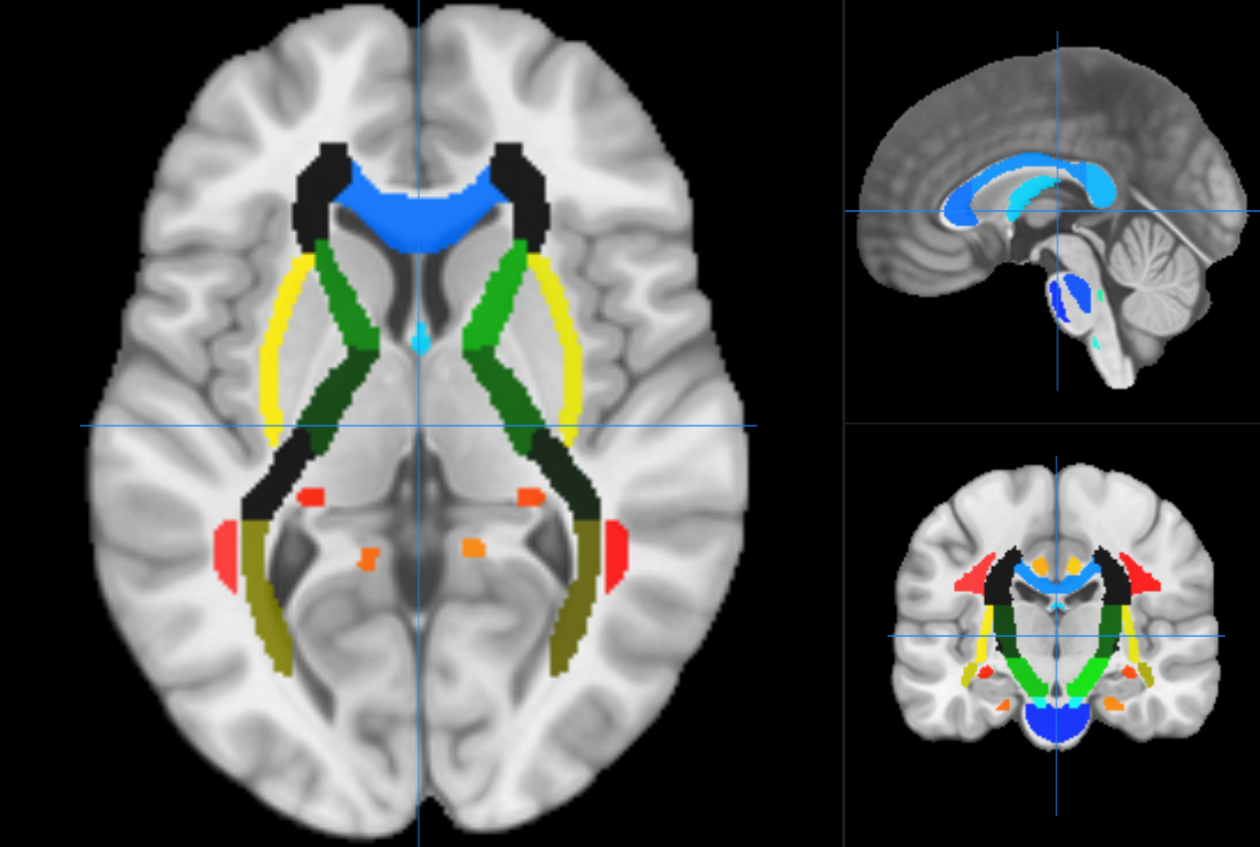
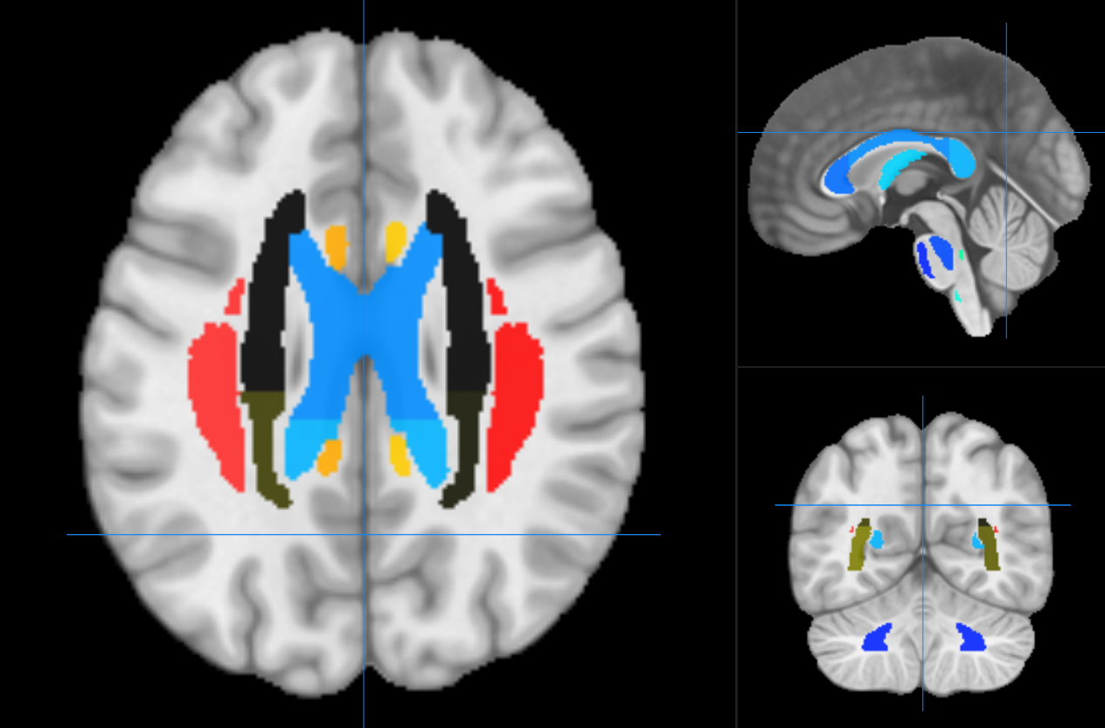
Methods
Data Processing
Six diffusion approaches calculated for JHU atlas
Diffusion Tensor Imaging (DTI) (4 metrics)
Diffusion Kurtosis Imaging (DKI) (3 metrics
Bayesian Rotationally Invariant Approach (BRIA) (10 metrics)
Spherical Mean Technique (SMT) (4 metrics)
multi-compartment SMT (mcSMT) (4 metrics)
White Matter Tract Integrity (WMTI) (3 metrics)
28 metrics x (20tracts + 48regions + 1mean) = 1932 diffusion features
Metrics inform about intra and extra axonal space, water fraction, fractional anisotropy
All being indicative of white matter characteristics, e.g. fiber density, axonal diameter, & myelination

Slide 22
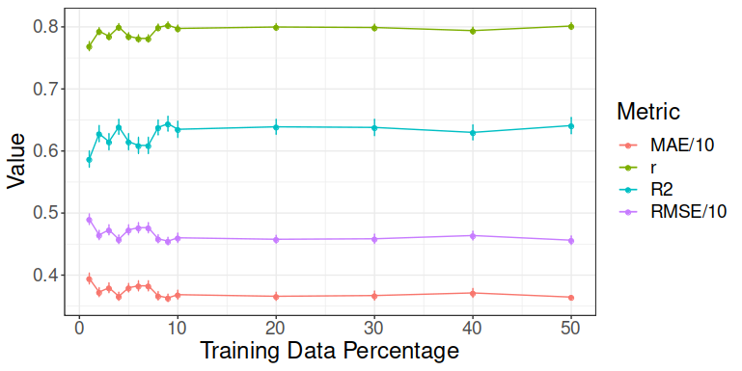
Methods
Model performance for different train-test splits using all data (1932 features, n = 35,749)
Trained models tested (10-fold cross val) on 50% data (opposite half of the highest train split) >> Train-test split fixed at 10%-90%

Slide 23
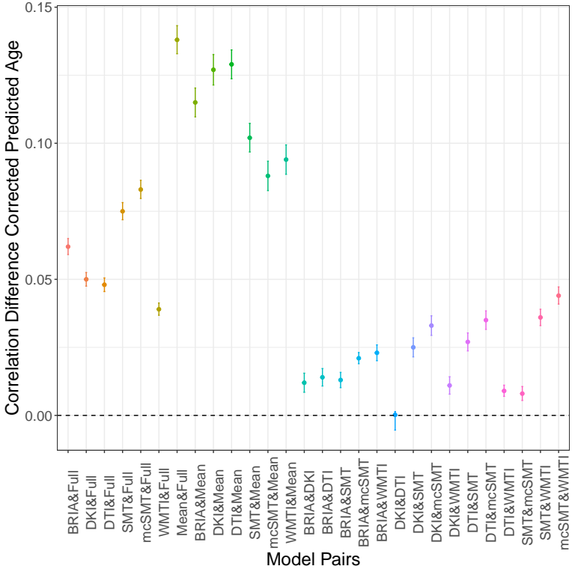
Results: uncorrected predictions
Bigger differences in model performance for uncorrected age
Approach | MRI features | R² | RMSE | MAE | Prediction-Age Correlation | Corrected Prediction-Age Correlation
BRIA | 690 | 0.550 (0.012) | 5.007 (0.057) | 4.002 (0.042) | 0.742 [0.737, 0.747] | 0.892 [0.889, 0.894]
DKI | 207 | 0.576 (0.015) | 4.958 (0.077) | 3.975 (0.068) | 0.754 [0.755, 0.764] | 0.903 [0.901, 0.905]
DTI | 276 | 0.571 (0.014) | 4.983 (0.072) | 3.984 (0.062) | 0.756 [0.751, 0.761] | 0.900 [0.897, 0.902]
SMT | 276 | 0.531 (0.010) | 5.214 (0.053) | 4.183 (0.036) | 0.729 [0.724, 0.734] | 0.899 [0.897, 0.901]
mcSMT | 276 | 0.519 (0.011) | 5.175 (0.045) | 4.153 (0.036) | 0.721 [0.716, 0.726] | 0.892 [0.889, 0.894]
WMTI | 207 | 0.585 (0.012) | 4.903 (0.065) | 3.928 (0.050) | 0.765 [0.761, 0.770] | 0.902 [0.900, 0.904]
Mean multimodal | 28 | 0.393 (0.012) | 5.932 (0.051) | 4.812 (0.046) | 0.627 [0.621, 0.634] | 0.905 [0.903, 0.907]
Full multimodal | 1932 | 0.645 (0.011) | 4.534 (0.041) | 3.624 (0.037) | 0.804 [0.800, 0.808] | 0.907 [0.905, 0.909]

Slide 24
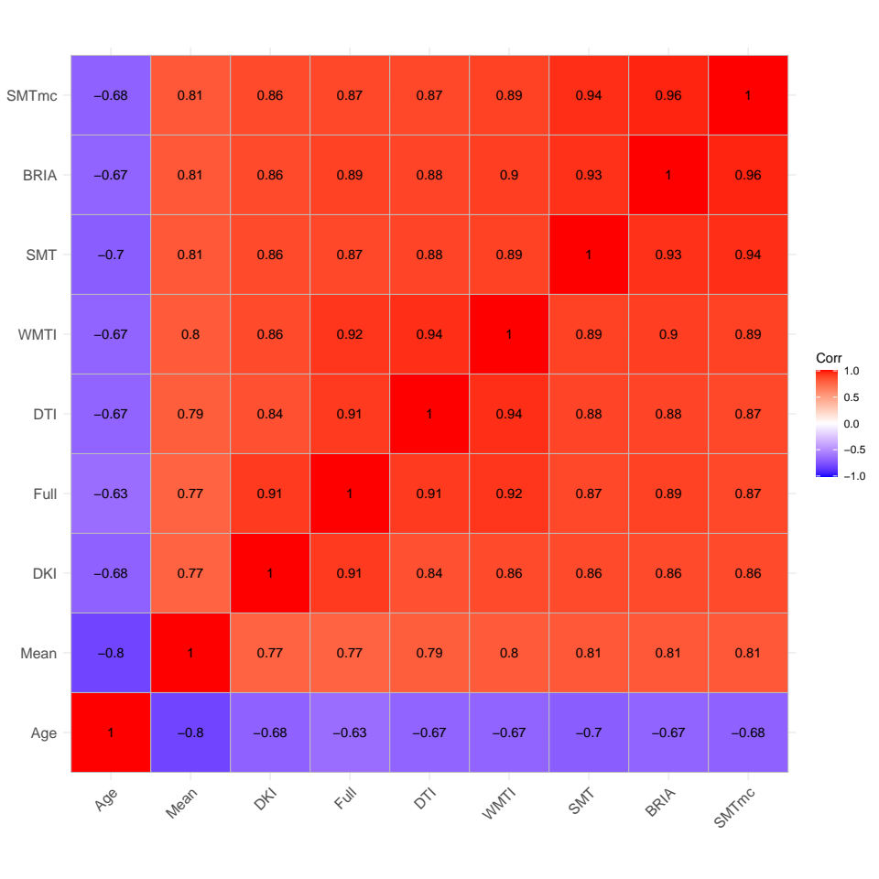
Results: uncorrected predictions
Correlations of uncorrected BAG and age across diffusion approaches
Associations between different diffusion approaches’ BAG are even stronger when NOT correcting for age

Slide 25
Linear?
Metric | LM AIC | GAM AIC | LM BIC | GAM BIC | LM R²_{adj} | GAM R²_{adj}
vintra | -126767.79 | -126755.60 | -126665.98 | -126662.27 | 0.36 | 0.36
vextra | -106952.81 | -106929.99 | -106851.00 | -106836.66 | 0.38 | 0.37
vCSF | -65781.67 | -65773.53 | -65679.86 | -65680.20 | 0.39 | 0.39
microRD | 633.36 | 643.11 | 735.18 | 736.43 | 0.39 | 0.39
microFA | -104706.06 | -104634.30 | -104604.25 | -104540.97 | 0.38 | 0.38
microAx | -54814.08 | -54790.59 | -54712.27 | -54697.26 | 0.27 | 0.27
microADC | -14954.91 | -14946.59 | -14853.10 | -14853.26 | 0.39 | 0.39
DRADextra | -177654.37 | -177648.58 | -177552.56 | -177555.25 | 0.30 | 0.30
DAXintra | -125641.12 | -125639.53 | -125539.31 | -125546.20 | 0.30 | 0.30
DAXextra | -138873.67 | -138808.20 | -138771.86 | -138714.87 | 0.09 | 0.09
RK | -34108.48 | -34109.41 | -34006.67 | -34016.08 | 0.37 | 0.37
AK | -146039.18 | -146041.08 | -145937.37 | -145947.75 | 0.32 | 0.32
MK | -85601.85 | -85603.57 | -85500.04 | -85510.24 | 0.36 | 0.36
FA | -103953.22 | -103924.62 | -103851.41 | -103831.30 | 0.31 | 0.31
MD | 12874.23 | 12878.93 | 12976.04 | 12972.25 | 0.35 | 0.35
RD | 18339.73 | 18359.69 | 18441.54 | 18453.02 | 0.34 | 0.34
AD | 6684.86 | 6689.75 | 6786.67 | 6783.08 | 0.35 | 0.35
smtFA | -57196.69 | -57161.31 | -57094.88 | -57067.98 | 0.31 | 0.31
smtLong | -686016.98 | -685869.48 | -685915.17 | -685776.15 | 0.06 | 0.05
smtMD | -507904.58 | -507869.45 | -507802.77 | -507776.13 | 0.30 | 0.30
smtTrans | -479144.23 | -479104.60 | -479042.42 | -479011.28 | 0.30 | 0.29
smtMCintra | -93427.21 | -93427.11 | -93325.40 | -93333.78 | 0.36 | 0.36
smtMCextraMD | -521137.14 | -521125.59 | -521035.33 | -521032.26 | 0.37 | 0.37
smtMCextratrans | -499929.78 | -499929.66 | -499827.97 | -499836.34 | 0.37 | 0.37
smtMCdiff | -575225.03 | -574996.85 | -575123.22 | -574903.53 | 0.22 | 0.21
AWF | -145979.93 | -145981.86 | -145878.11 | -145888.53 | 0.37 | 0.37
axEAD | 56711.05 | 56715.91 | 56812.86 | 56809.24 | 0.10 | 0.10
radEAD | 21189.85 | 21203.80 | 21291.67 | 21297.12 | 0.33 | 0.33
Also when allowing for splines, non-linear fit (GAM) was not better than linear models (LM) when predicting fornix features

Slide 26
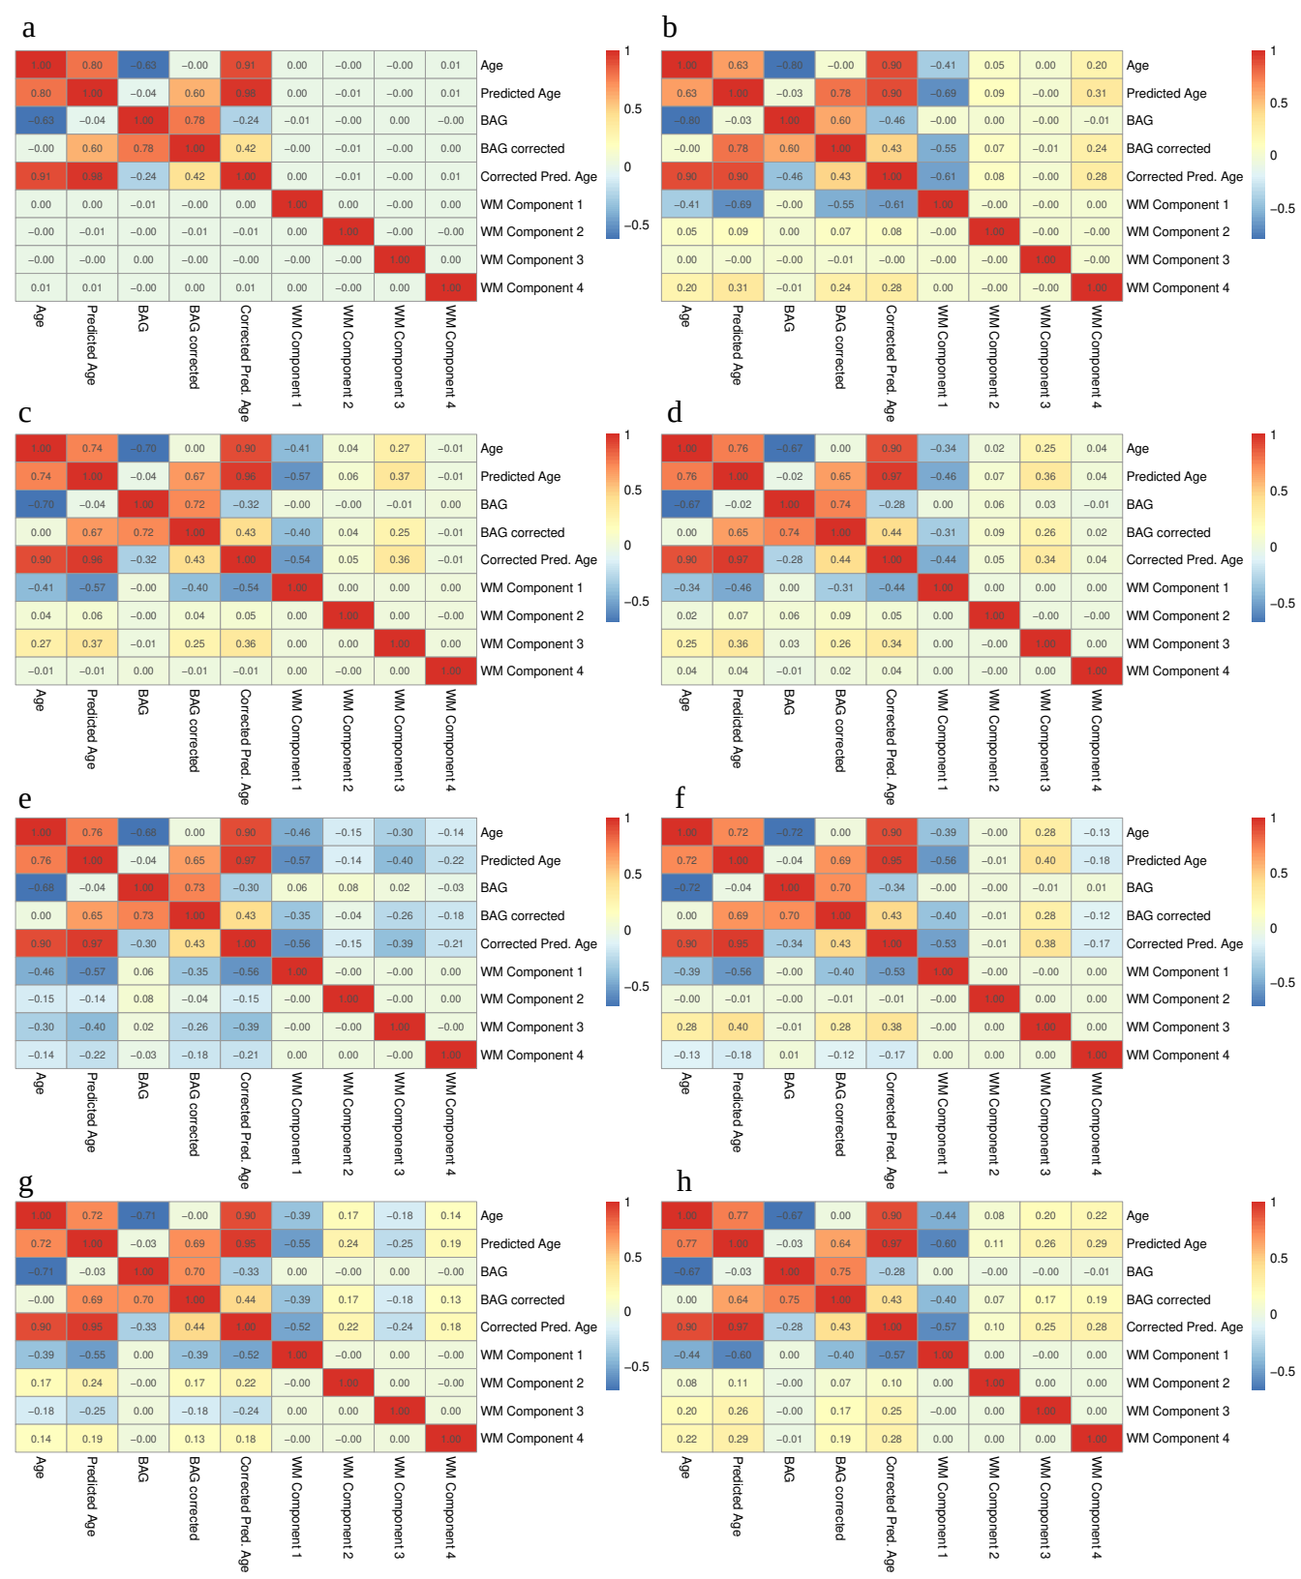
Missing BAG-WM relationships
Correlations of principal components, age, and brain age
a) full multimodal data, b) mean/whole brain average data, c) BRIA, d) DKI, e) DTI, f) SMT, g) SMT mc, h) WMTI

Slide 27
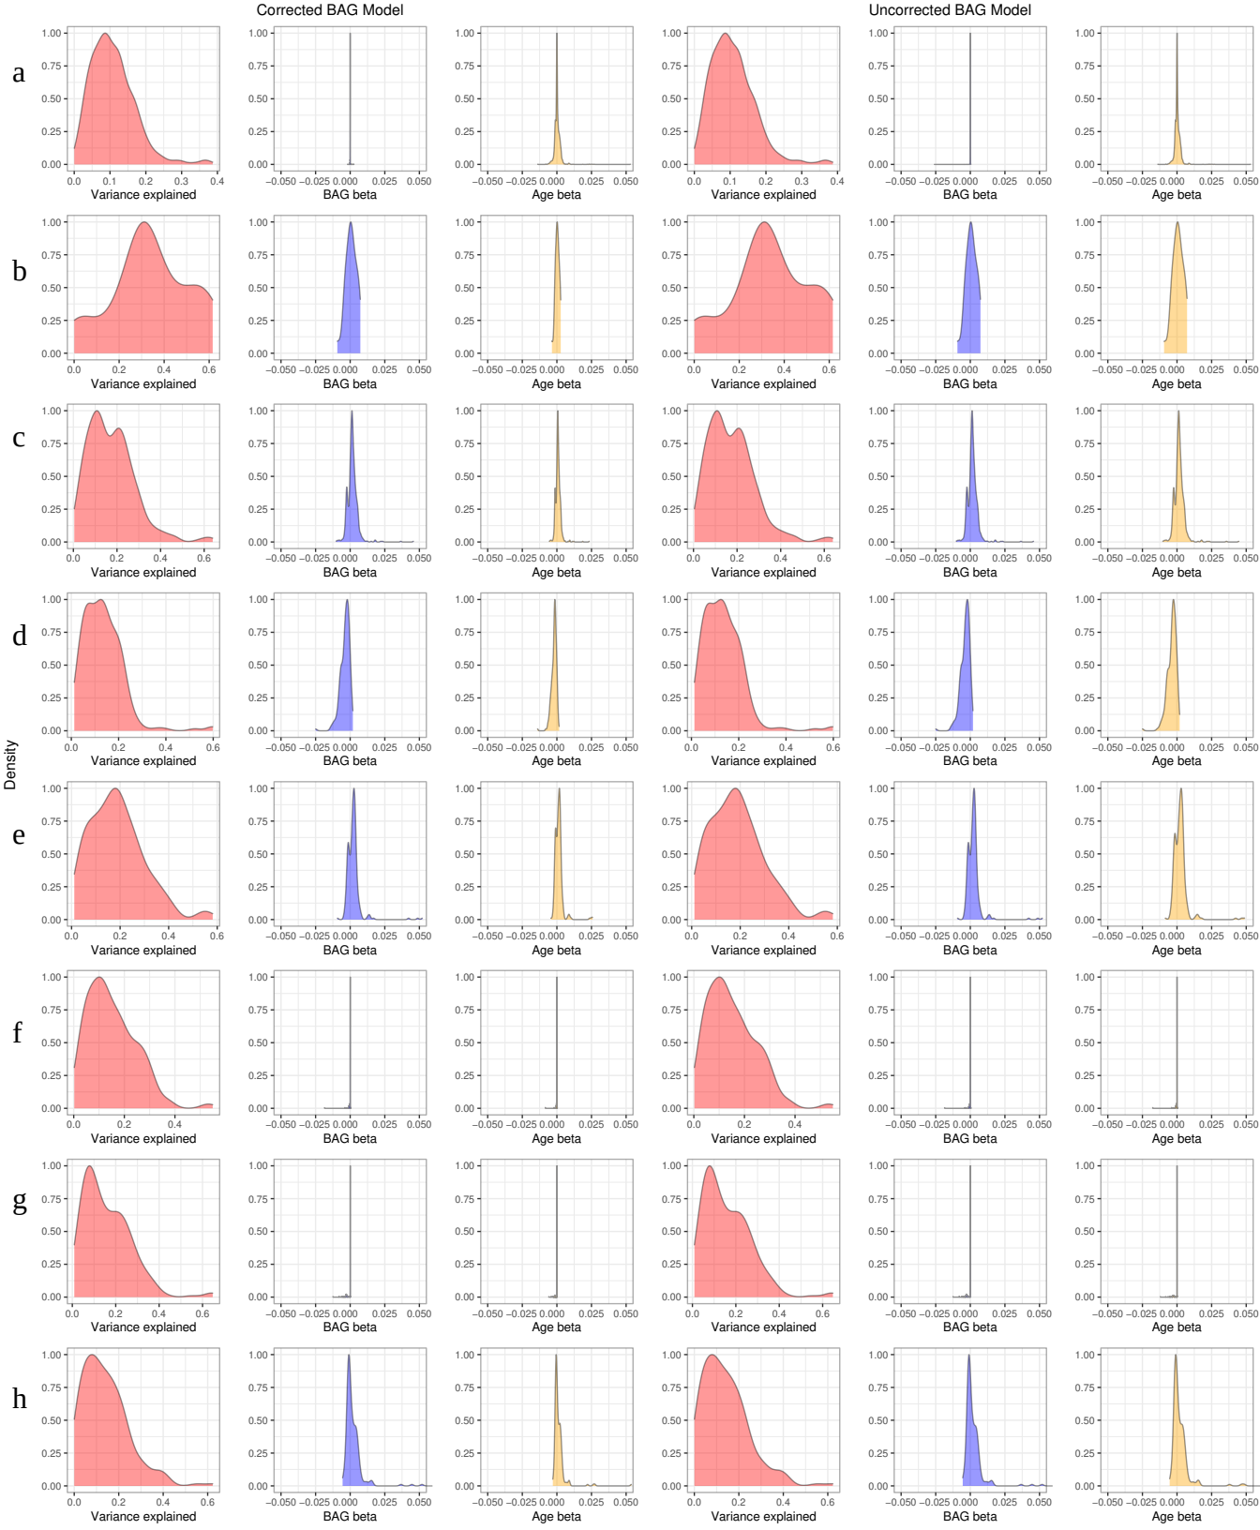
Missing BAG-WM relationships
Distributions of model stats for each predicted region
a) full multimodal data, b) mean/whole brain average data, c) BRIA, d) DKI, e) DTI, f) SMT, g) SMT mc, h) WMTI

